Slide 1


Bhagwan Mahavir University
Bhagwan Mahavir College of Education (M.Ed.)
Presented By :
Dr. Dilip M. Patel
Dean and Principal,Department of Education

Slide 2
About BMCE
“Bhagwan Mahavir College of Education", Surat perceives to be Nationally and Globally accepted centre of learning in field of Education with state of Art Education involving the changes in techniques of Learning, Teaching and Research to improve the quality of Education and Employability for all Stake holders.
Bhagwan Mahavir College of Education (M.Ed.) affiliated with Bhagwan Mahavir University, Vesu, Surat recognized by NCTE, Bhopal with intake capacity of 50 students is running 2-year M.Ed. course in regular mode.
The building surrounded by green fields and contains spacious classrooms, well documented library, a multipurpose halls, modern computer lab.

Slide 3
VISION OF THE COLLEGE
To empower education prepare well-rounded professors, who can effectively train educators and who can contribute in development of Society and Nation and prepare graduates for research skills and innovative teaching methods in curricula for Quality Education.

Slide 4
MISSION OF THE COLLEGE
M1 | To empower education prepare well-rounded professors, who can effectively train educators and who can contribute in development of Society and Nation and prepare graduates for research skills and innovative teaching methods in curricula for Quality Education.
M2 | To pursue continuous development of infrastructure and enhance state - of-art equipment to make our student tech savvy superior and develop leadership and management skills.
M3 | To collaborate with School / College,Various Educational Policies by Government, R& D institutes, to promote practical application of knowledge with International alliances to achieve global excellence.
M4 | To achieve overall excellence in education by continuously upgrading to understand diverse perspective of Teaching Learning process that will enhance Quality Education this in turn, will contribute to social and economic betterment of Society and Nation.
M5 | To focus on Overall development of students, who can contribute to various educational policies and reforms and prepare leaders in the global community.

Slide 5
Strategies for Achieving Vision/Mission
Curriculum development and instructional strategies
Implement a dynamic, learner-centered curriculum
Integrate technology and modern pedagogy.
Foster research aptitude.
Faculty development and support
Provide continuous professional development
Encourage professional growth
Create a supportive environment
Student engagement and support
Connect lessons to real-world applications.
Provide personalized and interactive learning.
Involve students in program improvement.
Community engagement and social responsibility
Develop community-based learning initiatives
Cultivate social consciousness
Share institutional resources.

Slide 6
Key highlights of the year
Celebration of festival with various skilled based activities
Effective classroom teaching with different approach and methods.
Seminar and conference

Slide 7
Governance & Administration
Organizational structure of the college
Education Dean, Principal
ERP Head
Academic Head
Exam Head
Programe Head
IQAC Head
Anti Raging Cell Head
Library Head
Admin
B. Ed.
M. Ed.
Committee Head
Subject Head
Subject Head
Social media Head
Website Head
Placement cell Head
R & D Cell Head
NSS Head
Cultural Committee Head
Women Cell Head
Sports Head
ICC Head
ST-SC Cell Head

Slide 8
Key Committees:
IQAC Committe
Sr No. | Name | Designation | Committee Designation
1 | Dr. Dilipbhai M. Patel | Principal & Dean | Chairman
2 | Dr. Nayna B. Chauhan | Asst. Professor | Coordinator
3 | Dr. Ramsingbhai A. Gamit | Asst. Professor | Secretary
4 | Dr. Bhavina R. Desai | Asst. Professor | Member
5 | Nitaben D. Mohite | Asst. Professor | Member
6 | Kalpanaben M. Patel | Asst. Professor | Member
7 | Divyeshkumar D. Patel | Asst. Professor | Member
8 | Dr. Vinodbhai G. Patel | Ex Principal V.T. choksi B.Ed.College | Invitee

Slide 9
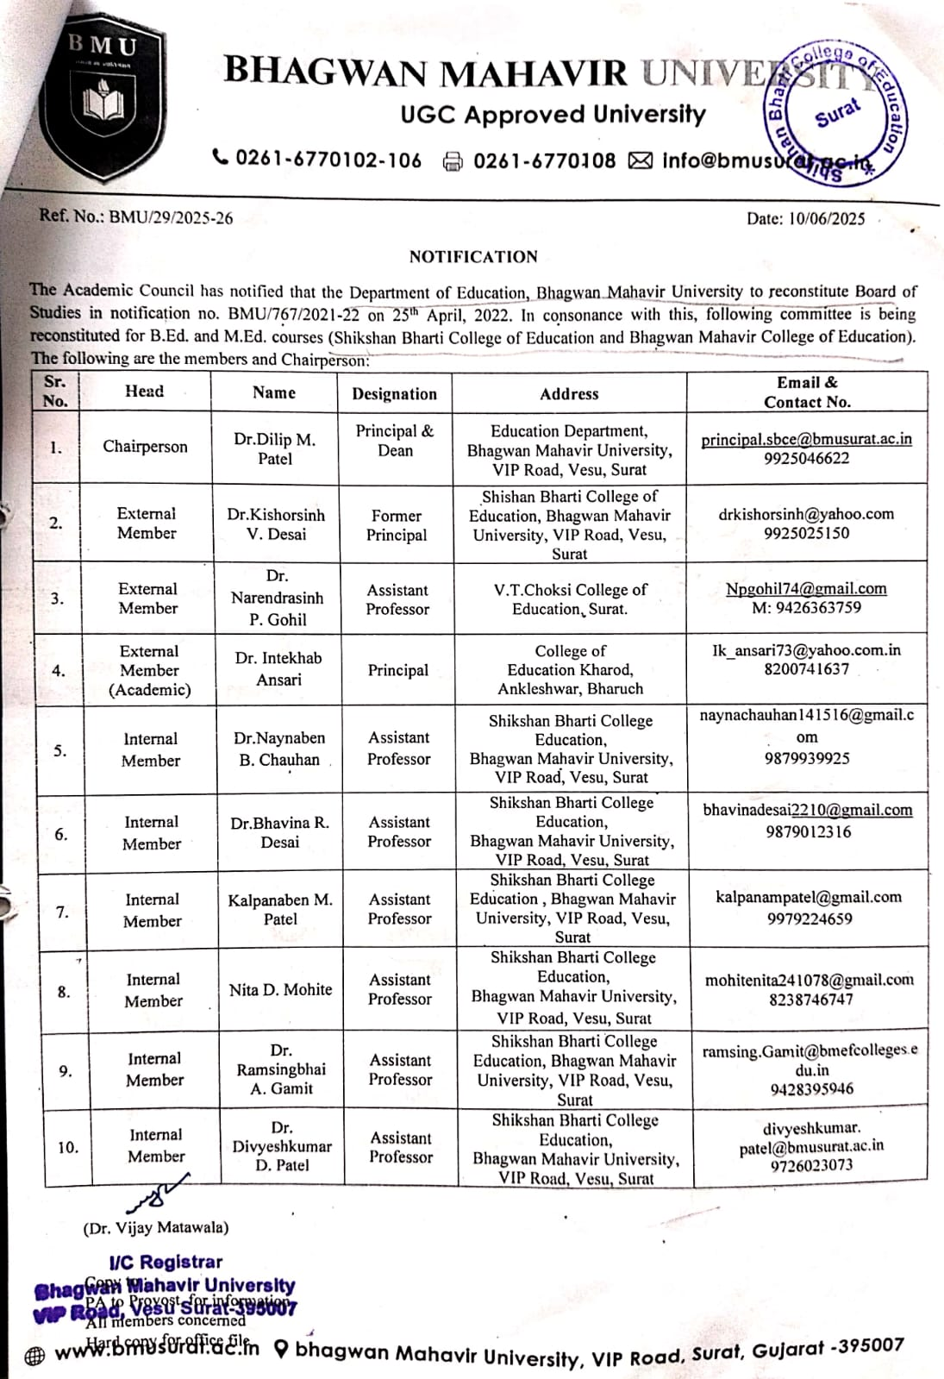
BoS Committee

Slide 10
Academic Programs
PG programs : M.Ed. with Intake (50 students),
Total Number of Students : 48
Number of faculty : 04
Sr. No. | Name of Program | Short Name | UG/PG | Intake
01 | Master of Education | M.Ed. | PG | 50

Slide 11
Student Profile
Enrollment statistics (last 3–5 years)
Name of Program | Course Level | No. of Students Admitted
 |  | AY-2022-23 | AY-2023-24 | AY-2024-25
M.Ed. | PG | 60 | 55 | 49
Student Admission Analysis (2024-25)
 |  | M | F | M | F | M | F | M | F | M | F | M | F | TOTAL
Program | Level | Open |  | EWS |  | SEBC/OBC |  | SC |  | ST |  | OVER ALL
M.Ed. | PG | 5 | 0 | 0 | 0 | 1 | 3 | 0 | 1 | 6 | 33 | 12 | 37 | 49

Slide 12
Faculty Profile
Sr. No | Name | Date of Joining | Qualification | Method | Research publication Paper Book |  | FDP | Workshop
01 | Dr. Dilip Patel | 20/1/22 | M.A., M.Com., M.Ed.,M.Phill, Ph.D. | Account | 65 | 24 | 28 | 24
02 | Dr.Kinnary Patel | 15/1/21 | M.Sc.,M.Ed., Ph.D. | Science & Maths | 14 | 06 | 18 | 21
03 | Dr. Madhavi Bhatt | 13/9/21 | M.A., M.Ed., Ph.D. | English | 05 | - | 04 | 05
04 | Dr. Amrut Patel | 16/2/23 | M.A., M.Ed., Ph.D. | Gujarati | 04 | - | 04 | 02
05 | Mrs. Manali Patel | 1/7/24 | M.Sc., M.Ed., Ph.D. (pursuing) | Science & Maths | 06 | - | - | 02

Slide 13
Infrastructure & Facilities
SR. NO. | FLOOR | ROOM NO. | ROOM NAME
1 | Ground Floor | 1001 | Assembly Room
2 | Ground Floor | 1002 | Psychology Lab
3 | Ground Floor | 1003 | Science Lab
4 | Ground Floor | 1004 | Maths/Science Class Room (Semester-2)
5 | Ground Floor | 1005 | Divyangjan Class Room
6 | Ground Floor | 1006 | B.Ed. Semester-4 (Div-2) Comp. Class Room
7 | Ground Floor | 1007-08 | Girls Room
8 | Ground Floor | 1009 | Language Lab
9 | Ground Floor | 1010 | Eco/A/c Class Room (Semester-2)
10 | Ground Floor | 1011 | Submission Room
11 | Ground Floor | 1012 | Store Room
12 | Ground Floor | 1013 | Students Washroom (Female)
13 | Ground Floor | 1014 | Students Washroom (Male)
14 | Ground Floor | 1015 | Lift

Slide 14
SR. NO. | FLOOR | ROOM NO. | ROOM NAME
1 | First Floor | 1101 | Staff Room (Female)
2 | First Floor | 1102 | B.Ed. Semester-2 (Div-2) Comp. Class Room / Social Science Class Room
3 | First Floor | 1103 | Library
4 | First Floor | 1104 | B.Ed. Semester-2 (Div-1) Comp. Class Room / Gujarati – Hindi Class Room
5 | First Floor | 1105-A | Exam Room
6 | First Floor | 1105-B | Staff Room (Male)
7 | First Floor | 1105-C | ERP Room
8 | First Floor | 1106-A | Clark Office
9 | First Floor | 1106-B | Principal Office
10 | First Floor | 1107 | English / Sanskrit Class Room
11 | First Floor | 1108 | Evaluation Room
12 | First Floor | 1109 | M.Ed. Semester-2 Class Room
13 | First Floor | 1110 | Research & Development Room
14 | First Floor | 1111 | M.Ed. Semester-4 Class Room
15 | First Floor | 1112 | B.Ed. Semester-4 (Div-1) Comp. Class Room
16 | First Floor | 1113 | Ladies Staff Washroom
17 | First Floor | 1114 | Gents Staff Washroom
18 | First Floor | 1115 | Lift

Slide 15
BHAGWAN MAHAVIR EDUCATION FOUNDATION
Organization Name |  | BHAGWAN MAHAVIR UNIVERSITY |  |  |  | Org Code |  | BMU
Institute Name |  | Education (B.Ed / M.Ed) |  |  |  | Inst. Code |  | 17
PARA - A & C : PC FOR STUDENT & STAFF
SR. NO | DESCRIPTION OF ASSETS |  | TOTAL CAPACITY QTY | TOTAL AVAILABLE QTY | WORKING STATUS
 |  |  |  |  | WORKIG |  | IN MAINTENANCE | HOLD
COMPUTER SET |  | FOR STUDENT | 50 | 0 | 0 |  | 0 | 50
 |  | FOR STAFF | 30 | 16 | 12 |  | 4 | 14
 |  | TOTAL | 80 | 16 | 12 |  | 4 | 64
1 | MONITER |  | 80 | 16 | 12 |  | 4 | 64
2 |  | EMBEDED CPU | 80 | 16 | 12 |  | 64 | 64
 |  | MOTHER BOARD | 80 | 16 | 12 |  | 64 | 64
 |  | PROCESSOR | 80 | 16 | 12 |  | 64 | 64
 |  | STOARAGE DEVICE | 80 | 16 | 12 |  | 64 | 64
 |  | RAM | 80 | 16 | 12 |  | 64 | 64
 |  | GRAPHICS CARD | 80 | 16 | 12 |  | 64 | 64
 |  | SMPS | 80 | 16 | 12 |  | 64 | 64
 |  | CABINET WITH SMPS | 80 | 16 | 12 |  | 64 | 64
3 | KEYBOARD |  | 80 | 16 | 12 |  | 64 | 64
4 | MOUSE |  | 80 | 16 | 12 |  | 64 | 64
5 | OPERATING SYSTEM |  | 80 | 16 | 12 |  | 64 | 64
6 | NET CONNECTION |  | 80 | 16 | 12 |  | 64 | 64

Slide 16
PARA - B COMMON ASSETS
SR. NO. | DESCRIPTION OF ASSETS | TOTAL AVAILABLE QTY | WORKING STATUS
 |  |  | WORKING | IN MAINTENANCE | HOLD
1 | PRINTER | 06 | 05 | 01 | 0
2 | SCANNER | 03 | 03 | 0 | 0
3 | NET SWITCH | 04 | 04 | 0 | 0
4 | NET SWITCH RACK | 0 | 0 | 0 | 0
5 | PROJECTOR | 02 | 02 | 0 | 0
6 | PROJECTOR SCREEN | 0 | 0 | 0 | 0
7 | PROJECTOR STAND | 0 | 0 | 0 | 0
8 | WEBCAM | 02 | 02 | 0 | 0
9 | HEAD PHONE | 0 | 0 | 0 | 0
10 | SOUND SYSTEM | 01 | 01 | 0 | 0
11 | EXTERNAL DVD WRITER | 0 | 0 | 0 | 0
12 | EXTERNAL HDD | 01 | 0 | 01 | 0
13 | PEN DRIVE | 0 | 0 | 0 | 0
14 | UPS | 03 | 03 | 0 | 0
15 | ONLINE UPS | 0 | 0 | 0 | 0
16 | STABILIZER | 0 | 0 | 0 | 0
17 | HIGH SPEED COPIER M/C | 0 | 0 | 0 | 0
18 | XEROX MACHINE | 01 | 01 | 0 | 0
19 | BIOMETRIC MACHINE | 01 | 01 | 0 | 0
20 | BARCODE READER | 0 | 0 | 0 | 0

Slide 17
Clubs, Cultural & Co-curricular Activities
Student clubs & associations
Women Cell club
Environment club
Cultural club
Research work club
Social activities club
Sports achievements : -
Cultural events, NSS/NCC activities
One week for nation
Competitions related to various festivals developing skills of students(e.g. varsha geet , debet,elocution, essay, craft,poster, decoration,etc.)

Slide 18
IQAC & Quality Initiatives
Agenda | Action Taken
1.Regarding Ph.D./ NET/ GSET of the professor | 4 faculties have completed their Ph.D. work. 1 faculties are undergoing Ph.D. while other faculties have been encouraged for Ph.D.2 faculty has done GSET
2.Regarding Publishing Research Paper/ Article/ Books of the professor | Most of the faculty and research papers and articles have been published. This has encouraged more and more research papers and articles to be published on the theme.
3.Introduced Bridge Course for first-year B.Ed. students. | A bridge course has been done for first year M.Ed. students.
4. Strengthened ICT-based teaching and digital learning platforms. | ICT and Digital based education is provided to M. Ed. trainees.
5.Organized value-based activities (Cultural programs, NSS, Yoga sessions). | Cultural programs, yoga activities are organized to provide value education to the M.Ed. trainees.
6.Maintained proper documentation for academic audits. | Documents are maintained properly according to audit attributes.

Slide 19
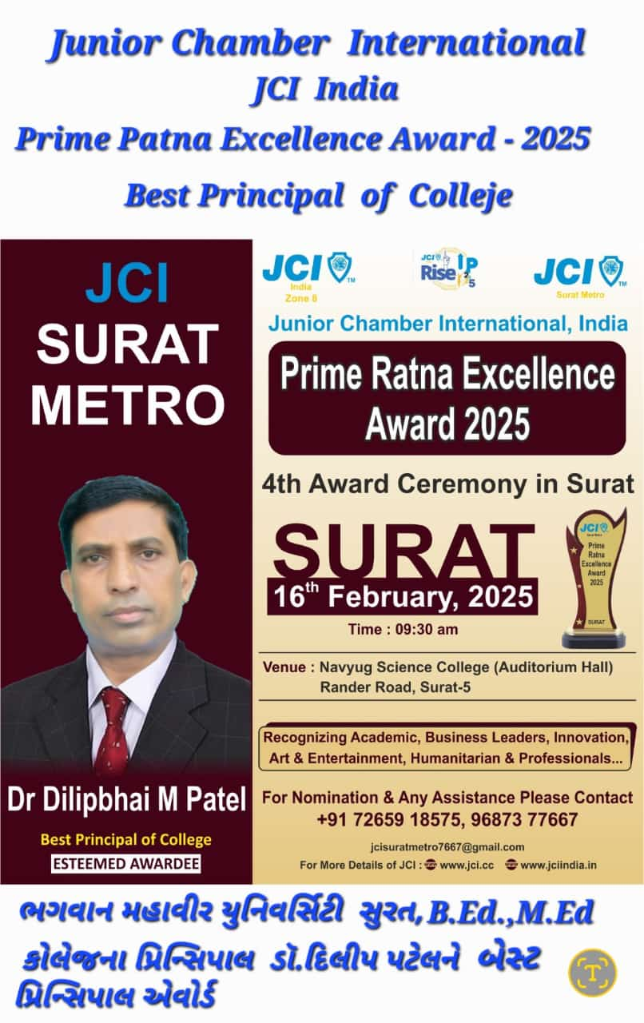
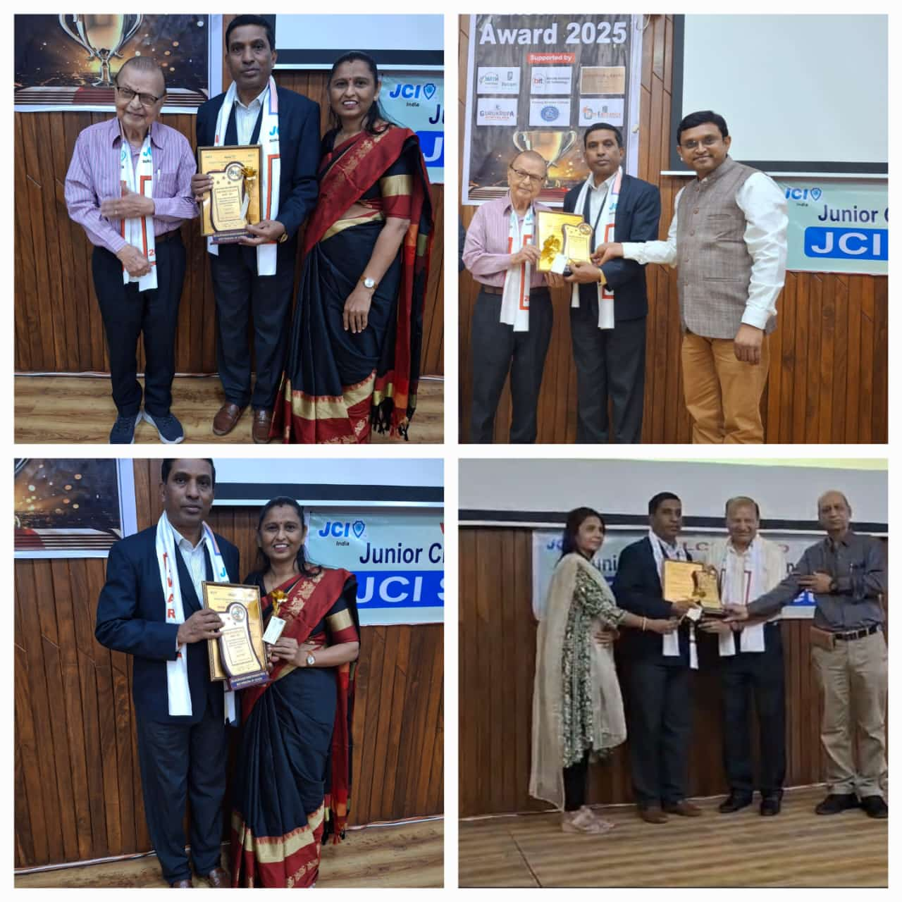
Achievements & Recognition
Awards & recognitions (faculty, students, institution)

Slide 20
Challenges & Action Plan
Current issues faced (admission, placement, funding, etc.)
Strategies to overcome challenges
Roadmap for next 1 year

Slide 21
Uniqueness/Best Practices of college
Title of the Best Practice :- MICRO TEACHING SKILLS BASED LEARNING (MTL)
To enable teacher trainees to learn and assimilate new teaching skills under controlled conditions.
To enable teacher trainees to master a number of teaching skills.
To enable teacher trainees to gain confidence in teaching.
To switch the teaching behaviors within the needed manner.
To modify the teaching method to achieve perfection in teaching.
Best Practice-II
Title ofthe Best Practice:- orientation Program
•To aware new entrants about the environment of the institution.
To familiarise new entrants with the history and future events of the institution. faculty
To create an atmosphere for new entrants to get to know other students and members.
To aware the students about the programme structure of B.Ed.
To generate the understanding that E-learning is the wheel for new innovations.
To create an online environment at this pandemic time.

Slide 22
Best Practices : III
Title of the Best Practice:- Internship Program for Second Year M.Ed Students
Understanding the school environment.
To develop teaching learning resources.
Formulation of unit-plan.
Creating daily lesson plans.
To develop and manage valuation instruments.
To organize teacher-parent meeting.
To organize curricular verbs.
To organize community service campaign.
Overview of different school scenarios.
Class room observation.
Addressing the school prayer meeting.
Creating a reflective diary.
To analyze the school syllabus and textbooks.
To study.
To conduct clinical trials and remedial teaching.

Slide 23
Future Plans
New academic programs to be launched
(1) Skill-Based & Add-on Courses
ICT in Education (Digital Tools for Teaching-Learning)
Communication Skills & Soft Skills for Teachers
Personality Development and Leadership Training
Yoga & Mindfulness for Teachers
(2) NEP-2020 Based Innovative Programs
Educational Technology & AI in Education
Environmental Education and Sustainable Development
Value Education & Human Rights Education
(3) Short-Term Certificate Courses (3–6 months)
Educational Research & Data Analysis (Using SPSS/Excel)
Art & Drama in Education
Digital Lesson Planning & E-Content Creation
(4) College-Based Enrichment Programs
Peer Teaching & Mentorship Program
School Internship Enhancement Program
Language Enrichment (English/Gujarati Communication)
(5) Collaboration-Based Programs
MoU with Local Schools for Innovation Labs
ICT Training Program in Collaboration with NGOs or DIET

Slide 24
Research & innovation goals
Research Goals :
To study the use of innovative educational methods in the field of education.
To explore how educational technology (ICT) is used effectively in education.
Action Research
Innovation Goals :
ICT-based Teaching Tools (Smart Class, Google Classroom, LMS)
Game-based learning, Project-based learning,
Digital Lesson Plan Bank

Slide 25
Infrastructure development plans
Academic Infrastructure
Classrooms:
  Smart classrooms with ICT facilities
  LCD projectors, whiteboards, Wi-Fi connectivity
Library Development:
  Digital library facility
  Subscription to e-journals, e-books
Laboratories:
  Psychology Lab
  Science Lab
  Computer & ICT Lab
  Language Lab
  Curriculum Lab / Teaching Aid Preparation Room

Slide 26
Conclusion
BMCE has made very effective and significant progress in the all-round development of the trainees.
BMCE has a very distinguished reputation for quality education and training.
Along with education, training is provided along with various co-curricular and social activities, so that skills are developed in the trainees.
It has earned a reputation as the best college in the entire Gujarat.
The principal and staff of the college always work proactively for the placement of trainees in different schools
The principal and staff perform their important duty to provide systematic guidance to the trainees for various competitive examinations
The Principal, staff, trainees, former trainees, various schools-colleges, and parents have made excellent contributions to the progress of the college.
Educational spelling, research etc. has been encouraged through school activities and educational relations so that the college has been very leading in maintaining the educational approach.

Slide 27
Thank You

